Slide 1

Creating a Self-Audit System for Bank Users to Detect Fraudulent Activities
- Group 6 -
Elyan Palladino | Woon Sup Kim
Shivam Bathija | Laurensia Charlene Gono
Yushan Lin
01

Slide 2
Agenda
1. The Problem & Research Questions
3. Results
2. The Data & Analytical Techniques Used
4. Conclusion & Recommendations

Slide 3

The Problem
Banks provide services that notify their clients of any suspicious activities as card fraudulent activities keep increasing. Yet currently there is no service for users to self-audit their transactions.
A self-audit system will allow customers to review their transactions, highlighted purchases that may fraudulent, add a competitive advantage to the bank, and give consumers peace of mind.

Slide 4
Research Questions
1
2
3
Are there any specific geographical locations with more fraudulent activities?
Are there any specific merchant categories with more fraudulent activities?
Can suspicious transactions and purchase patterns be determined without analyzing individual transactions?

Slide 5
The Data & Analytical Techniques Used
The Raw Data: Credit card transactions from January 1st, 2019 through December 31st, 2020. Contains transactions from 999 unique credit cards, with 1,852,394 observations and 23 variables with no missing values.
Prepare Data
Cluster Analyses
Spatial Analyses
Notes:
The simulator has certain pre-defined list of merchants, customers and transaction categories. And then using a python library called "faker", and with the number of customers, merchants that you mention during simulation, an intermediate list is created.
After this, depending on the profile you choose for e.g. "adults 2550 female rural.json" (which means simulation properties of adult females in the age range of 25-50 who are from rural areas), the transactions are created. Say, for this profile, you could check "Sparkov | Github | adults2550female_rural.json", there are parameter value ranges defined in terms of min, max transactions per day, distribution of transactions across days of the week and normal distribution properties (mean, standard deviation) for amounts in various categories. Using these measures of distributions, the transactions are generated using faker.

Slide 6
Technique: Clustering
$ Spent | Merchant Category
Done on dollar spent, clustering analysis helps understand the users’ purchasing behavior without analyzing individual transactions. Large clusters would indicate common purchase behavior of the credit card user. Conversely, small clusters would indicate irregular purchase behavior. The transactions in the small clusters will be flagged as potential fraudulent transactions. | An independent clustering analysis can be conducted on merchant categories to identify merchants that customers do not regularly visit and flag them as potential fraudulent transactions.

Slide 7
Analysis
Cluster based on number of transactions to create different user profiles.
7 User profiles have been created:
Profile 1: ~4400 transactions in the past 2 years (31 users)
Profile 2: ~3800 transactions in the past 2 years (57 users)
Profile 3: ~3000 transactions in the past 2 years (238 users)
Profile 4: ~2500 transactions in the past 2 years (96 users)
Profile 5: ~1700 transactions in the past 2 years (194 users)
Profile 6: ~1000 transactions in the past 2 years (130 users)
Profile 7: ~300 transactions in the past 2 years (247 users)
Notes:
Number of personas determined through silhouette method.
Used kmeans clustering to cluster the users into different personas.

Slide 8
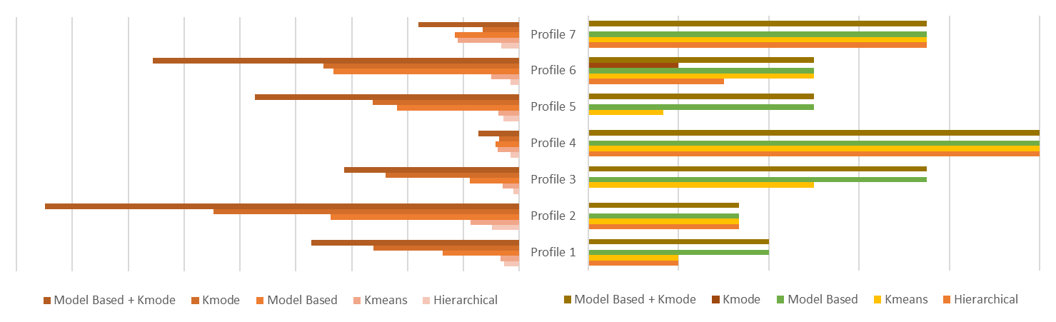
Analysis
Select a representative from each profile (the centroid of the cluster) and conduct different clustering techniques on dollar spent and merchant category to detect fraudulent transactions
False Positives
Specificity
Notes:
Hierarchical and Kmeans: Dollar spent was used for clustering with 9 clusters. (number of clusters determined through silhouette model)
Model Based: Dollar spent was used for clustering with 8 clusters. (number of clusters determined through the Mclust with highest BIC)
The graph shows how the different techniques performed for each personas.
The red graph on the left shows the number of false positives. The graph on the right shows the specificity.
Specificity is the important metric for fraud detection.

Slide 9
Analysis Summary
 | Best Model | Specificity | True Positives | False Positives
Profile 1 | Model Based | 40% | 6 | 137
Profile 2 | Hierarchical | 33% | 1 | 49
Profile 3 | Model Based | 75% | 3 | 89
Profile 4 | Hierarchical | 100% | 2 | 15
Profile 5 | Model Based | 50% | 3 | 219
Profile 6 | Hierarchical | 100% | 3 | 15
Profile 7 | Hierarchical | 75% | 3 | 32
The model with the highest specificity and the lowest false positives was selected for each profile.
Model Based, and Hierarchical Clustering performed the best
None of the models worked sufficiently well for profile 1, 2, and 5.
There were many false positives for all models.

Slide 10
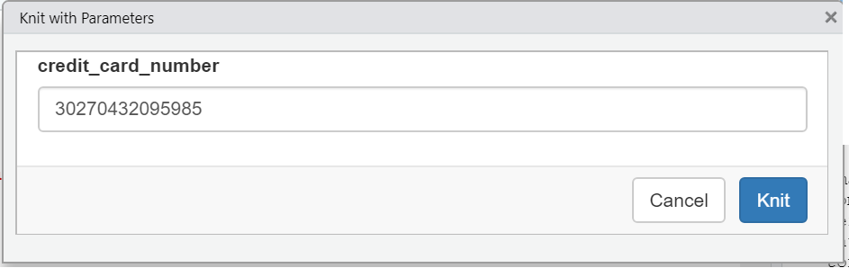
Demo and Results
# of Transactions: 4392 (Profile 1)
Best Method: Model Based Clustering

Slide 11
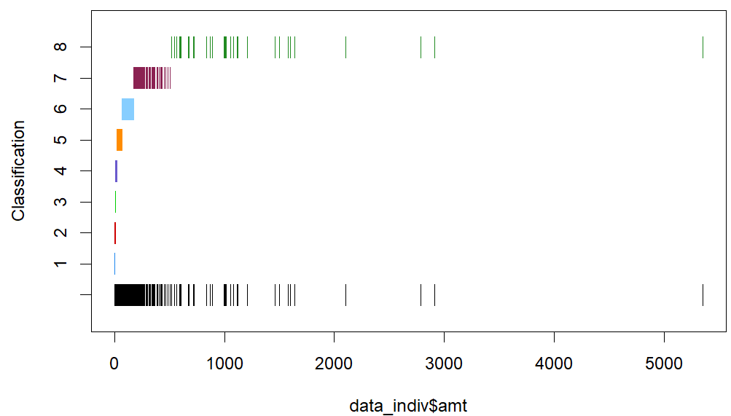
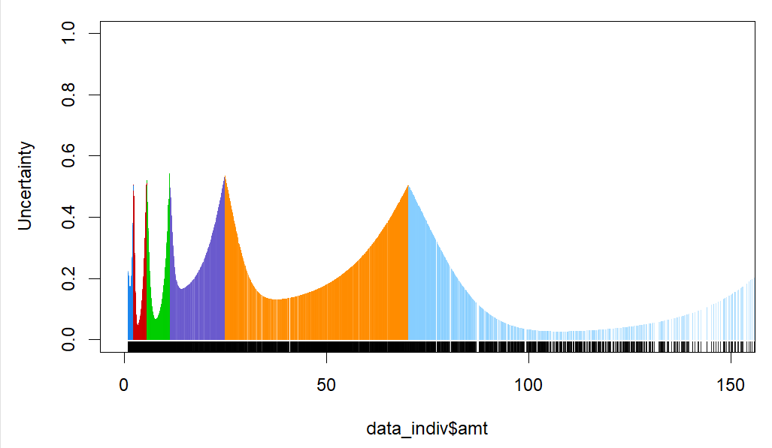
Demo and Results
Fig 1. Clustering Classification
Fig 2. Uncertainties of Data Points in Clusters
Notes:
Model based clustering performed the best out of all the other clustering techniques but from the uncertainties graph we can already see that the results will not be precise and should be taken with a grain of salt.
What we’re really interested in are the small clusters. And according to the uncertainty graph, a lot of the data points in the small clusters have high uncertainty.

Slide 12
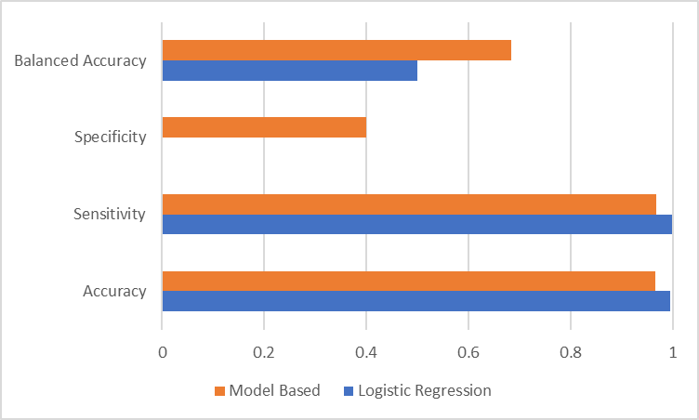
Demo and Results
Comparing the performance against a simple logistic regression.
 | Model Based | Logistic Regression
Actual Fraud Count | 15 | 15
Predicted Fraud Count | 143 | 1
Predicted Correct | 6 | 0
% Detected | 40.0% | 0
% Correct | 4.2% | 0
Notes:
Actual Fraud Count: 15
Predicted Fraud Count: 143
Correctly Predicted: 6
% detected: 40%
Prediction Accuracy (correct prediction / total prediction): 4.2%
Specificity still better than simple logistic regression. Suggesting that its performance is better than supervised method. (ie analyzing individual transactions).

Slide 13
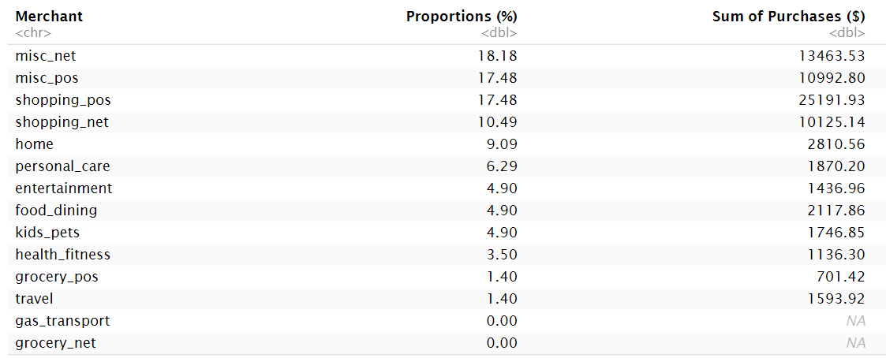
Demo and Results
Merchants with Predicted Fraudulent Activities

Slide 14

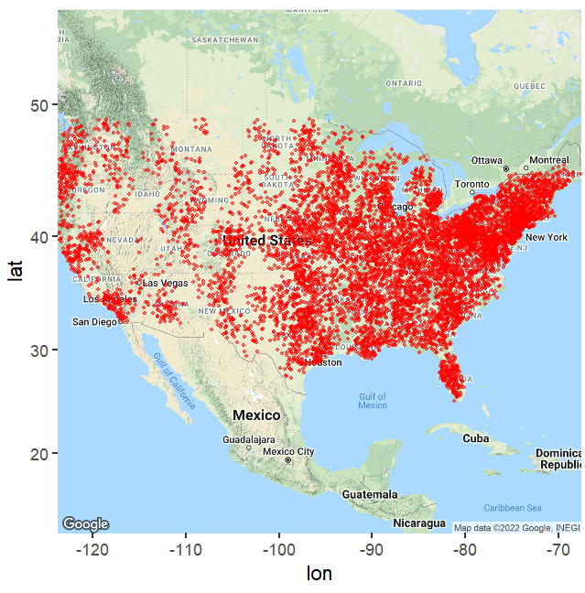
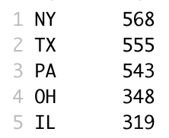
Results:Spatial Analyses
Actual Fraud Merchant Locations
3 out of the 5 top states with most activities are in the East.
While majority of the transactions are in the East, it’s worth noting that these are also where majority of the people live.

Slide 15

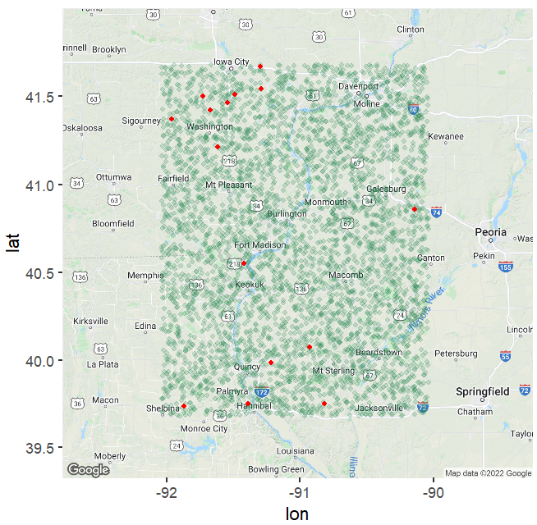
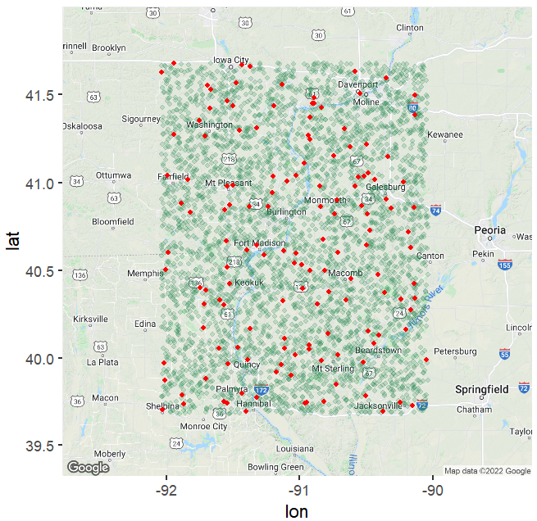
Results:Spatial Analyses
Actual Fraud for the User
Predicted Fraud for the User
Notes:
there doesn't seem to really be a pattern with regards to merchant location.
it's also worth noting that the dataset is simulated data, not actual survey of real fraud activities.
This might explain why there's no apparent pattern (and why this person only makes purchases in that square)

Slide 16
Conclusion & Recommendations
4 out of 7 Personas
Detects Fraud Well.
Further development needed for the other 3 profiles.
80% - 98%
Many False Positives.
The customers should be encouraged to verify detected transactions.
Limit Time Frame
Performing the models on limited transactions may produce better results.
Notes:
None of the models worked sufficiently well for Profile 1, 2, and 5.
This service can be offered to customers similar to profile 3, 4, 6 and 7 but a different model should be developed for users similar to profile 1, 2 and 5.
In general, all the models produced a lot of false positives. The customers should be made known of this characteristic and be encourage them to verify the detected fraudulent transactions. This could be due to the simulated nature of the data and other data should be considered.
In general, the models seems to work well for users with smaller number of transactions. Maybe prompt the user for a timeframe, limiting the amount of transactions data to perform analysis.

Slide 17
Thank You!
Any Questions?

